Slide 1

Algorithms and Data Structures 2 CS 1501
Spring 2022
Sherif Khattab
ksm73@pitt.edu
(Slides are adapted from Dr. Ramirez’s and Dr. Farnan’s CS1501 slides.)

Slide 2
Announcements
Upcoming deadlines:
Lab 8 due on 3/25
Homework 9 due on 3/28
Assignment 2 due on 3/28
Lab 9 due on 4/1

Slide 3
Previous Lecture …
Prim’s and Kruskal’s MST algorithms

Slide 4
CourseMIRROR Reflections (most confusing)
What is the best edge? The one before the vertex or the one after?
Prims algorithm was very confusing
Determining the runtime of prims algorithm was confusing
The method of calculating a low value and num value for a specific vertex of a graph was most confusing. Additionally, the calculation of the MST of a graph was also confusing.
I thought the algorithm to construct the Prims was a bit confusing
Still a missing something with articulation point algorithm. Hope to have a homework problem to work through
I was confused about which vertex to check edges from in Prims Algorithm

Slide 5
CourseMIRROR Reflections (most confusing)
For the non-naïve Prim’s algorithm, how are best edge and parent array values determined and then later overwritten?
Why we multiply 2 in the runtime analysis of Best edge searching for graph implemented by matrix prim’s algorithm to find mst
The order of using prims algorithm
Finding the minimum edge value for each node in the traversal of the new Prim’s algorithm

Slide 6
CourseMIRROR Reflections (most interesting)
prim algorithm run time
optimizing Prim’s algorithm with the parent and best edge arrays
That we are able to cut down the runtime by only seeing the best edges
I found it interesting how Kruskal Algorithm used a priority queue to solve the minimum spanning tree problem
Tracing through the algorithms
minimum spanning tree

Slide 7
CourseMIRROR Reflections (most interesting)
How DFS can find articulation points through the low and num values
The new articulation point retrieval example was very helpful to go through
I thought the way you are able to find the lowest cost by such a simple algorithm is interesting
Kruskals algorithm seems interesting. Want to see more of it next lecture
The possibilities of prims

Slide 8
Repetitive Minimum Problem
Input:
a (large) dynamic set of data items in the form of
Output:
find a minimum item
You are implementing an algorithm that repeats this problem
examples of such an algorithm?
Prim’s, Huffman tree construction
What we cover today applies to the repetitive maximum problem as well

Slide 9
Let’s create an ADT!
The Priority Queue ADT
Primary operations of the PQ:
Insert
Find item with highest priority
e.g., findMin() or findMax()
Remove an item with highest priority
e.g., removeMin() or removeMax()
We mentioned priority queues in building Huffman tries
How do we implement these operations?
Simplest approach: arrays

Slide 10
Unsorted array PQ
Insert:
Add new item to the end of the array
Θ(1)
Find:
Search for the highest priority item (e.g., min or max)
Θ(n)
Remove:
Search for the highest priority item and delete
Θ(n)
Runtime for use in Huffman tree generation?
Notes:
Θ(k²)
have to perform 2*k removals

Slide 11
Sorted array PQ
Insert:
Add new item in appropriate sorted order
Θ(n)
Find:
Return the item at the end of the array
Θ(1)
Remove:
Return and delete the item at the end of the array
Θ(1)
Runtime for use in Huffman tree generation?
Notes:
Θ(k²)
Have to insert n initial trees

Slide 12
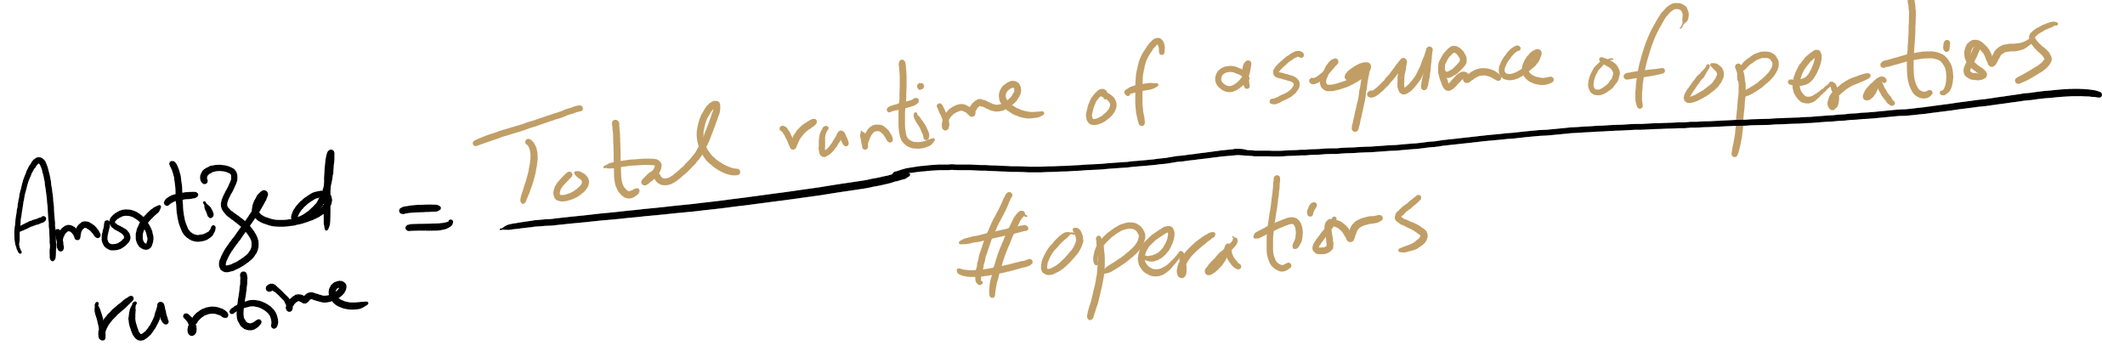
Amortized Runtime

Slide 13
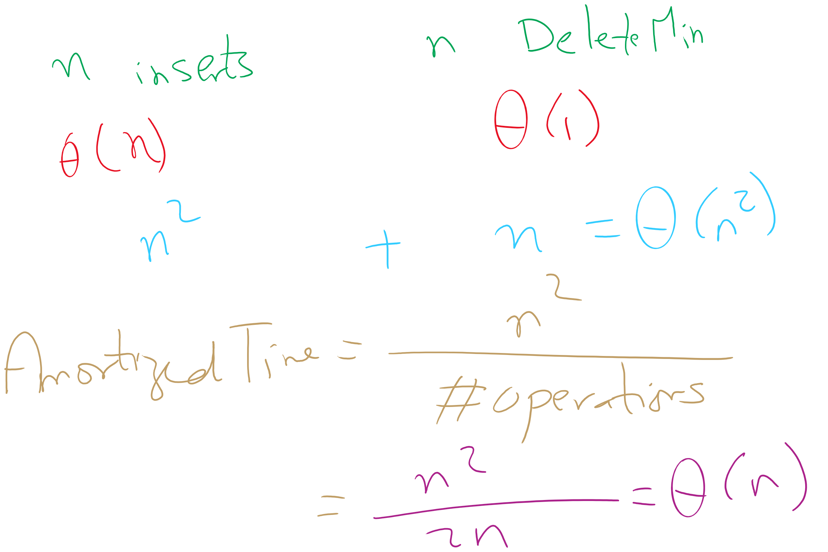
Amortized Time

Slide 14
So what other options do we have?
What about a binary search tree?
Insert
Average case of Θ(lg n), but worst case of Θ(n)
Find
Average case of Θ(lg n), but worst case of Θ(n)
Remove
Average case of Θ(lg n), but worst case of Θ(n)
OK, so in the average case, all operations are Θ(lg n)
No constant time operations
Worst case is Θ(n) for all operations

Slide 15
Is a BST overkill?
Our find and remove operations only need the highest priority item, not to find/remove any item
Can we take advantage of this to improve our runtime?
Yes!

Slide 16
The heap
A heap is complete binary tree such that for each node T in the tree:
T.item is of a higher priority than T.right_child.item
T.item is of a higher priority than T.left_child.item
It does not matter how T.left_child.item relates to T.right_child.item
This is a relaxation of the approach needed by a BST
The heap property

Slide 17
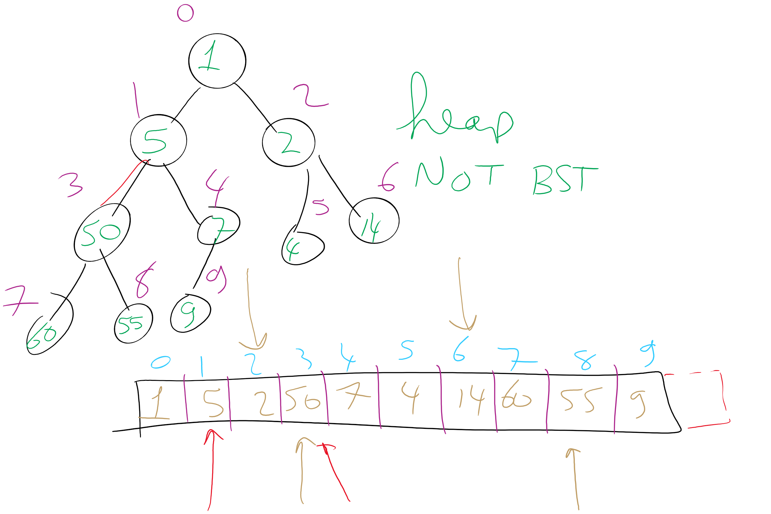
Heap Example

Slide 18
Heap PQ runtimes
Find is easy
Simply the root of the tree
Θ(1)
Remove and insert are not quite so trivial
The tree is modified and the heap property must be maintained

Slide 19
Heap insert
Add a new node at the next available leaf
Push the new node up the tree until it is supporting the heap property

Slide 20
Min heap insert
Insert: 7, 42, 37, 5, 8, 15, 12, 9, 3
7
5
3
3
5
15
7
12
5
42
37
42
37
15
3
5
7
9
8
15
12
9
42
9
3
Notes:
Insert: 7, 42, 37, 5, 8, 15, 12, 9, 3

Slide 21
Heap insert
Add a new node at the next available leaf
Push the new node up the tree until it is supporting the heap property

Slide 22
Min heap insert
Insert: 7, 42, 37, 5, 8, 15, 12, 9, 3
7
5
3
3
5
15
7
12
5
42
37
42
37
15
3
5
7
9
8
15
12
9
42
9
3
Notes:
Insert: 7, 42, 37, 5, 8, 15, 12, 9, 3

Slide 23
Heap remove
Tricky to delete root…
So let's simply overwrite the root with the item from the last leaf and delete the last leaf
But then the root is violating the heap property…
So we push the root down the tree until it is supporting the heap property

Slide 24
Min heap removal
3
9
42
5
7
NO!
5
9
8
7
42
8
12
9
7
8
9
42
37
15
42
9
Notes:
Remove 2x, illustrate to students you need to be careful how you swap on the way down (with the "NO!")

Slide 25
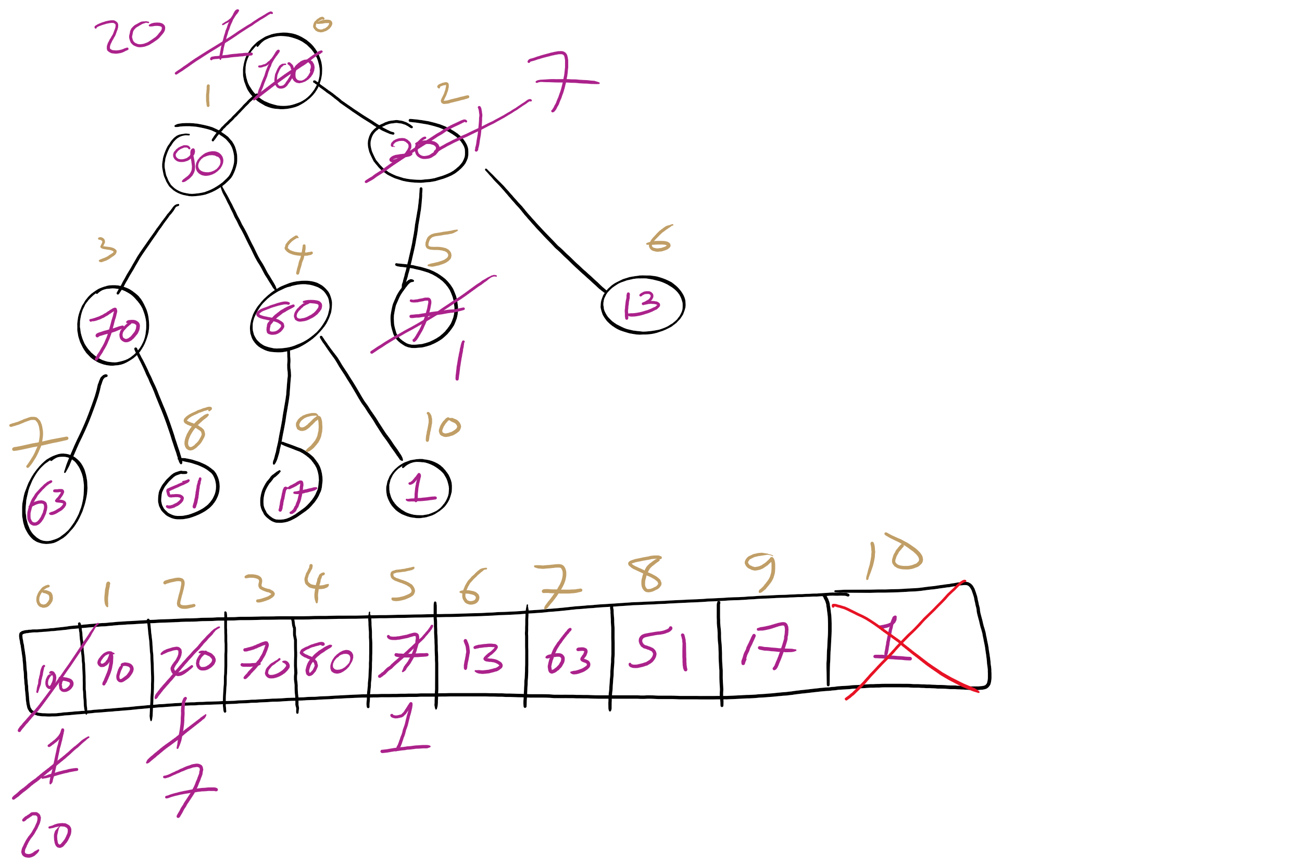
Heap removeMax Example

Slide 26
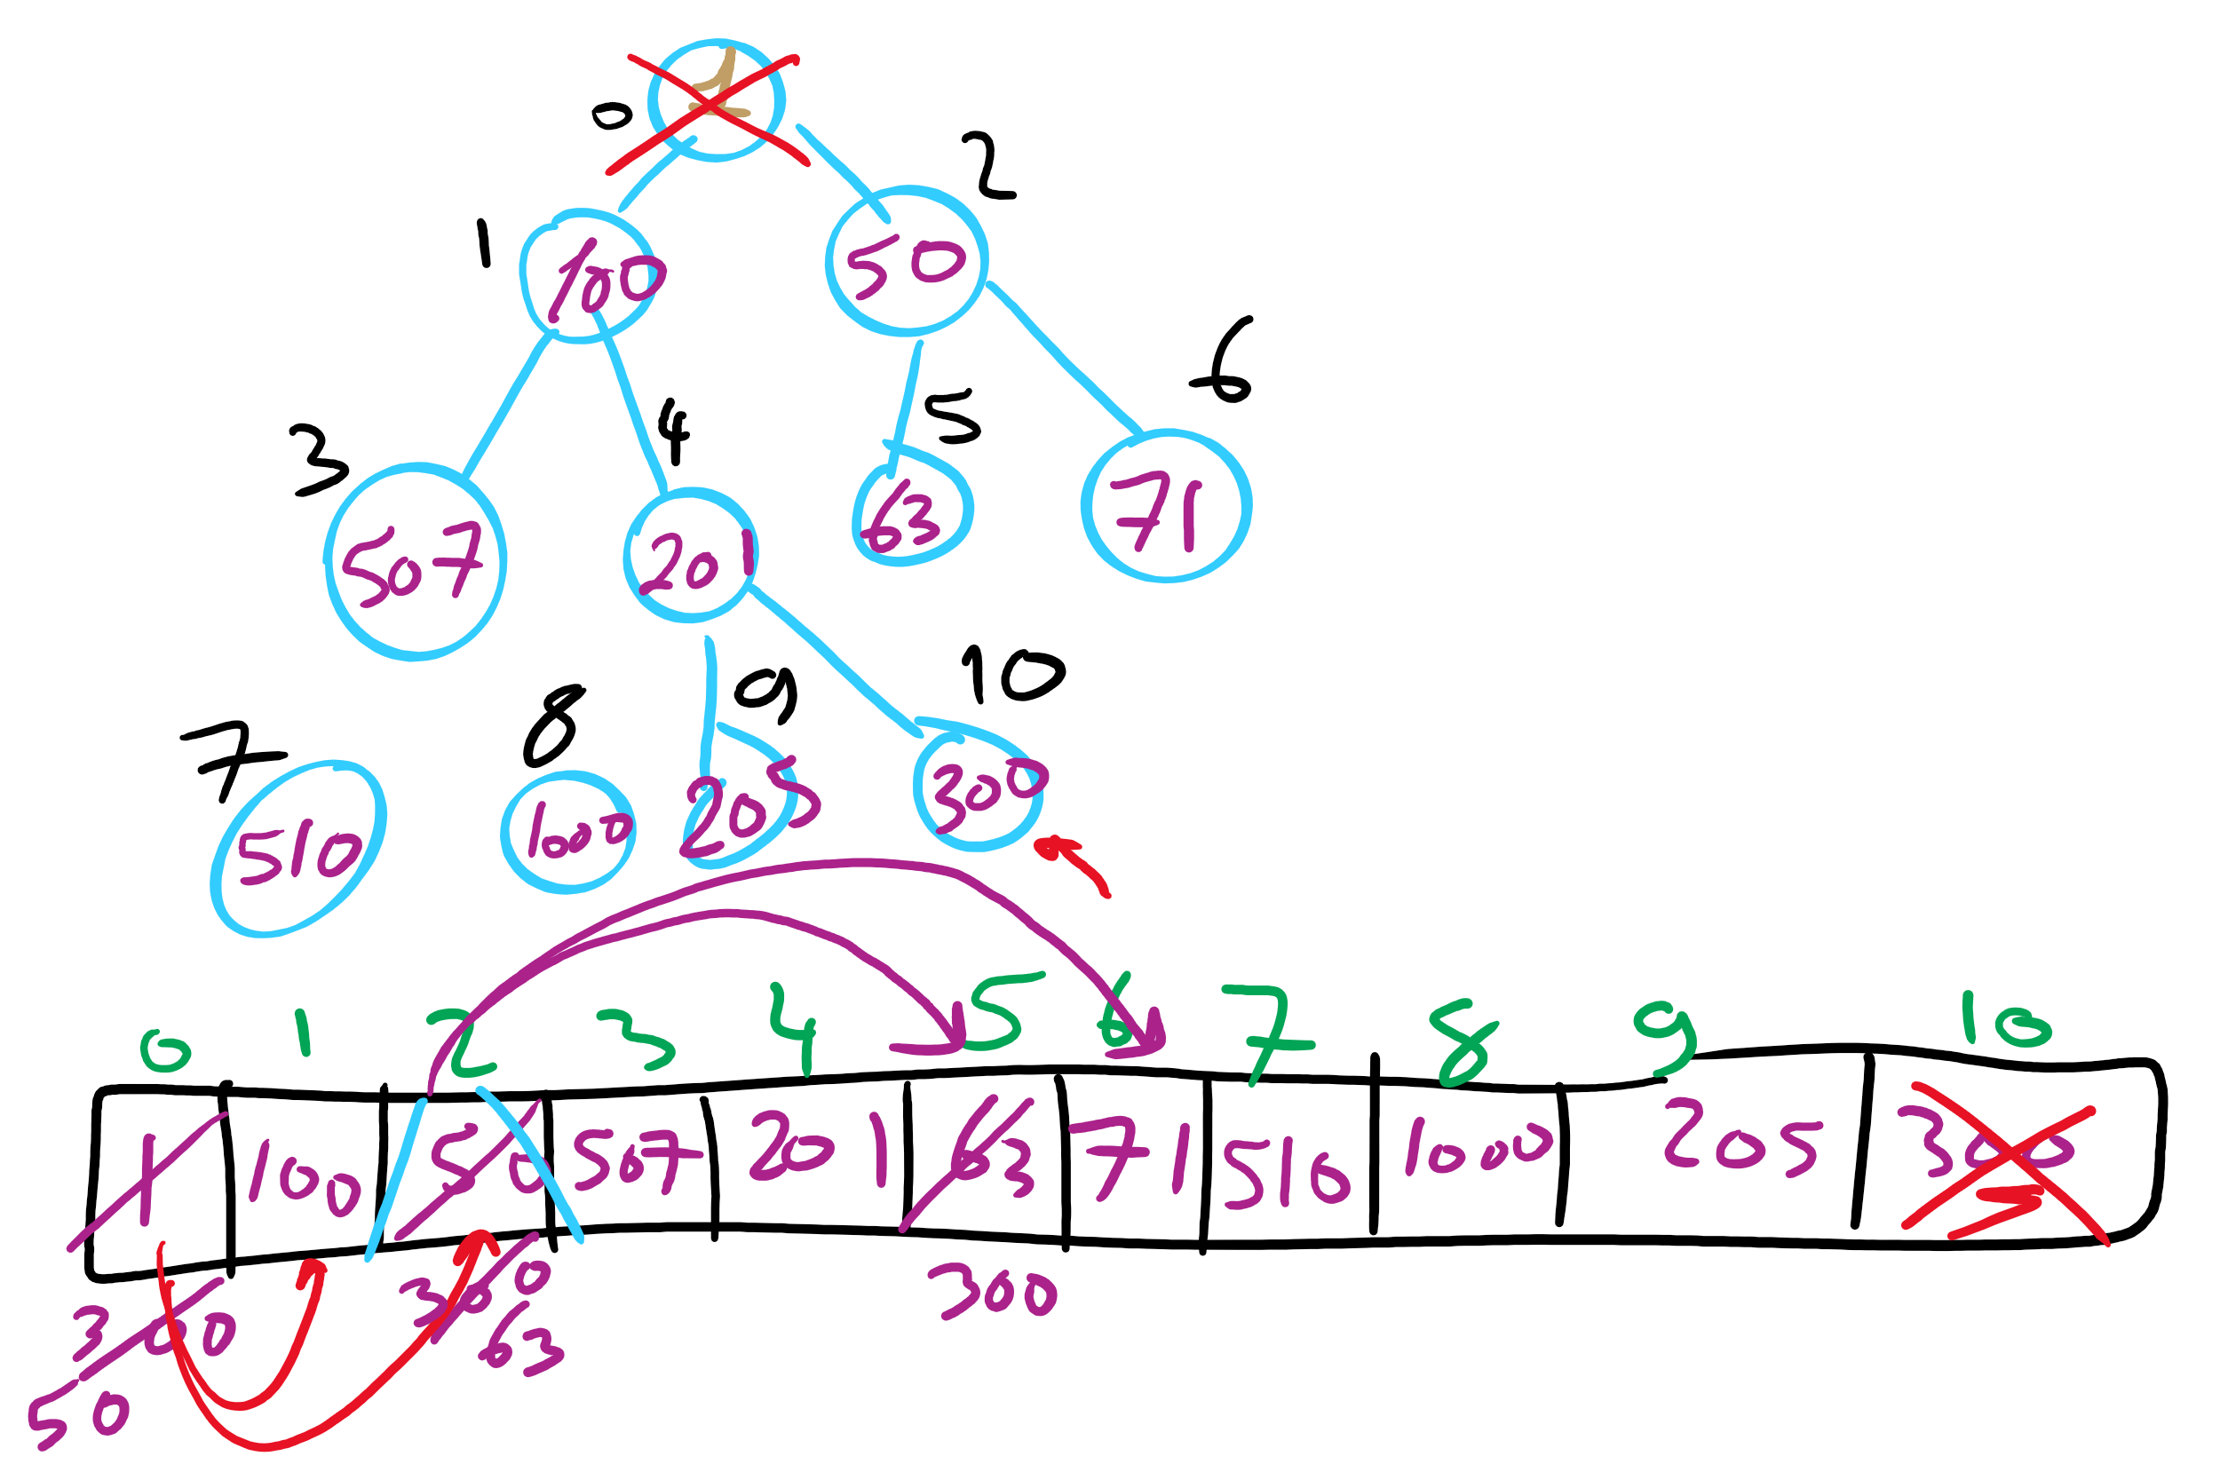
Heap removeMin Example

Slide 27
Heap runtimes
Find
Θ(1)
Insert and remove
Height of a complete binary tree is lg n
At most, upheap and downheap operations traverse the height of the tree
Hence, insert and remove are Θ(lg n)

Slide 28
Heap implementation
Simply implement tree nodes like for BST
This requires overhead for dynamic node allocation
Also must follow chains of parent/child relations to traverse the tree
Note that a heap will be a complete binary tree…
We can easily represent a complete binary tree using an array

Slide 29
Storing a heap in an array
Number nodes row-wise starting at 0
Use these numbers as indices in the array
Now, for node at index i
parent(i) = ⌊(i - 1) / 2⌋
left_child(i) = 2i + 1
right_child(i) = 2i + 2
For arrays indexed from 0
Notes:
Insert: 7, 42, 37, 5, 8, 15, 12, 9, 3

Slide 30
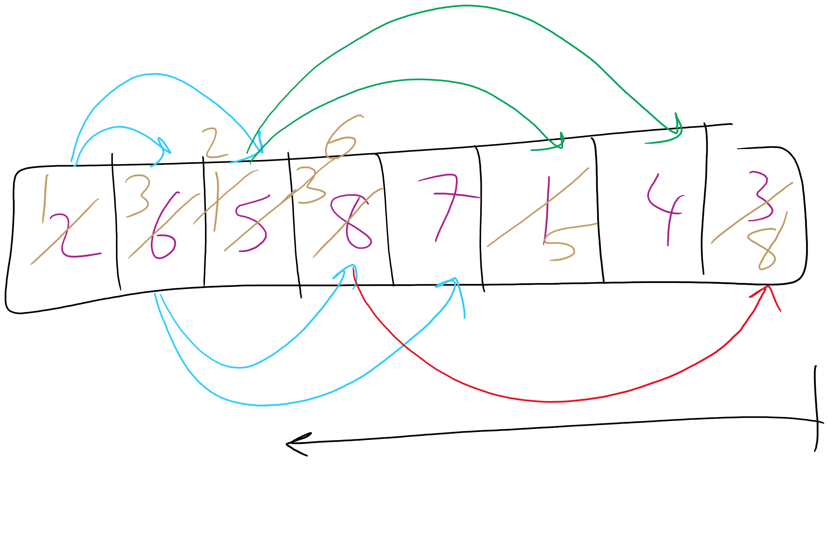
Heapify Operation

Slide 31
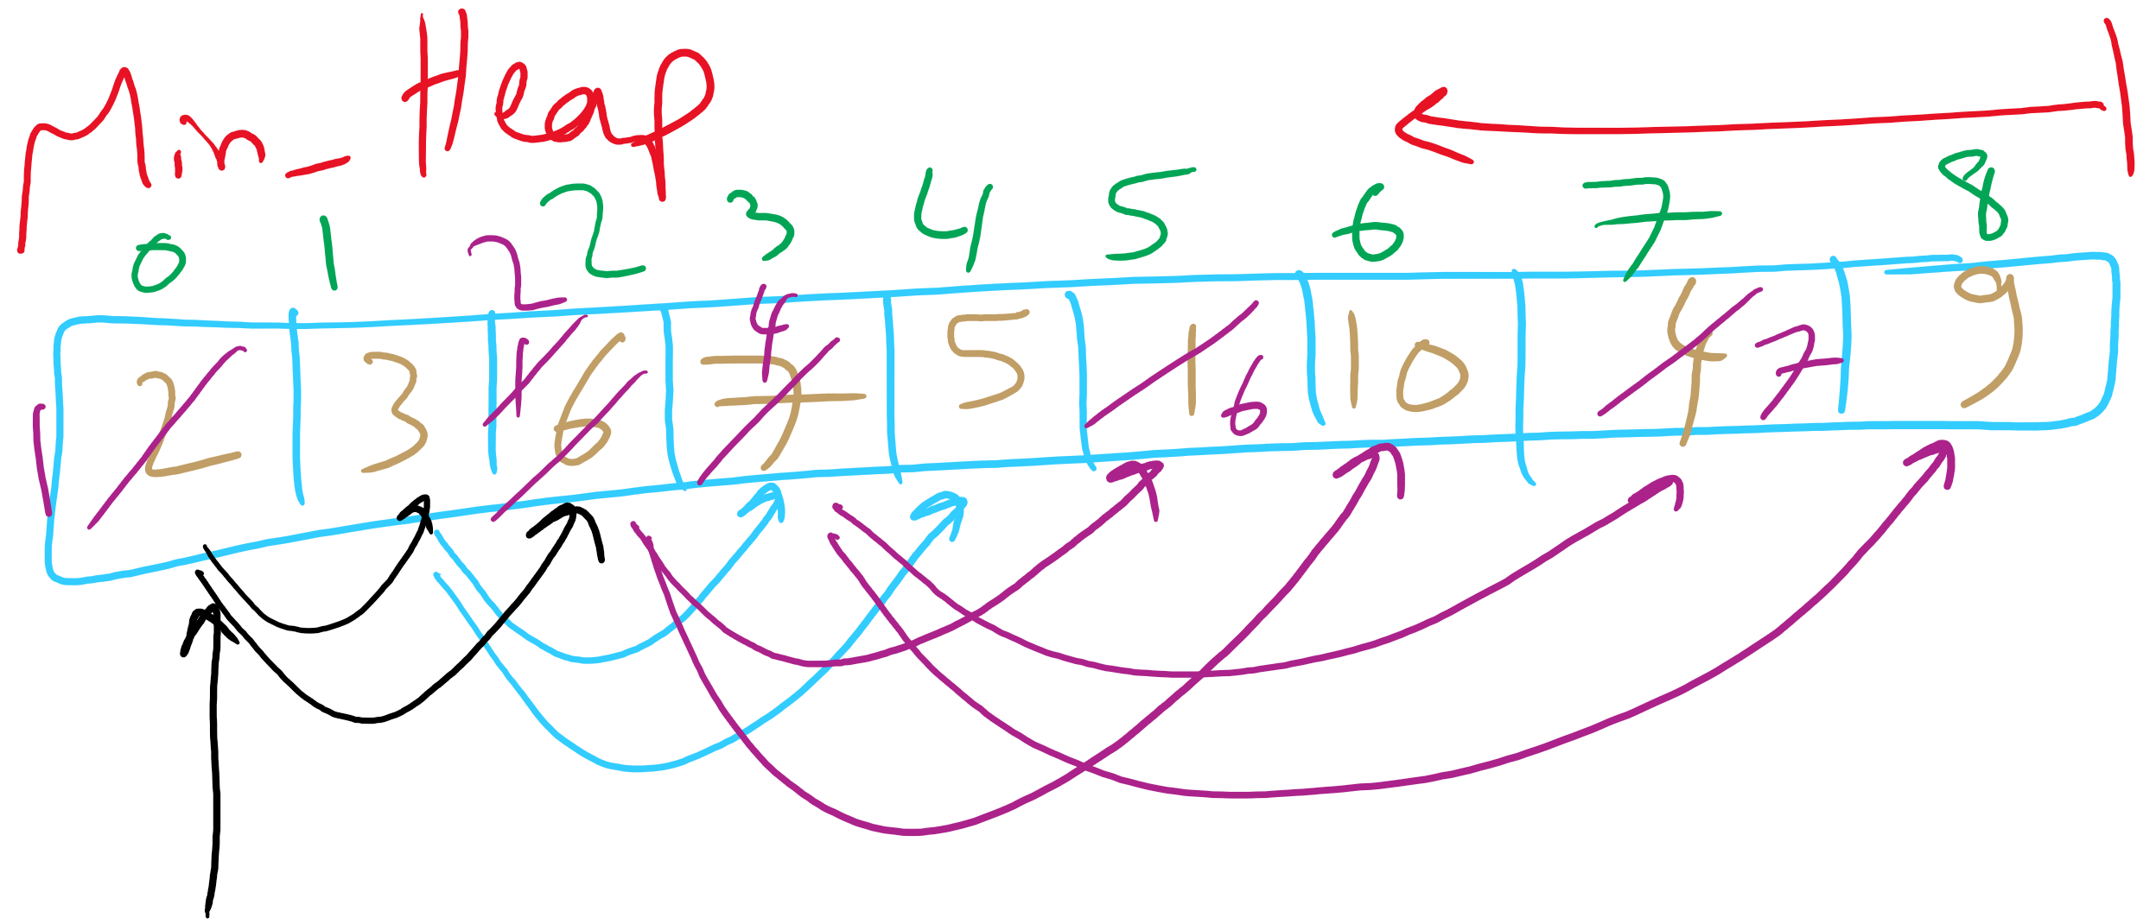
Heapify Example

Slide 32
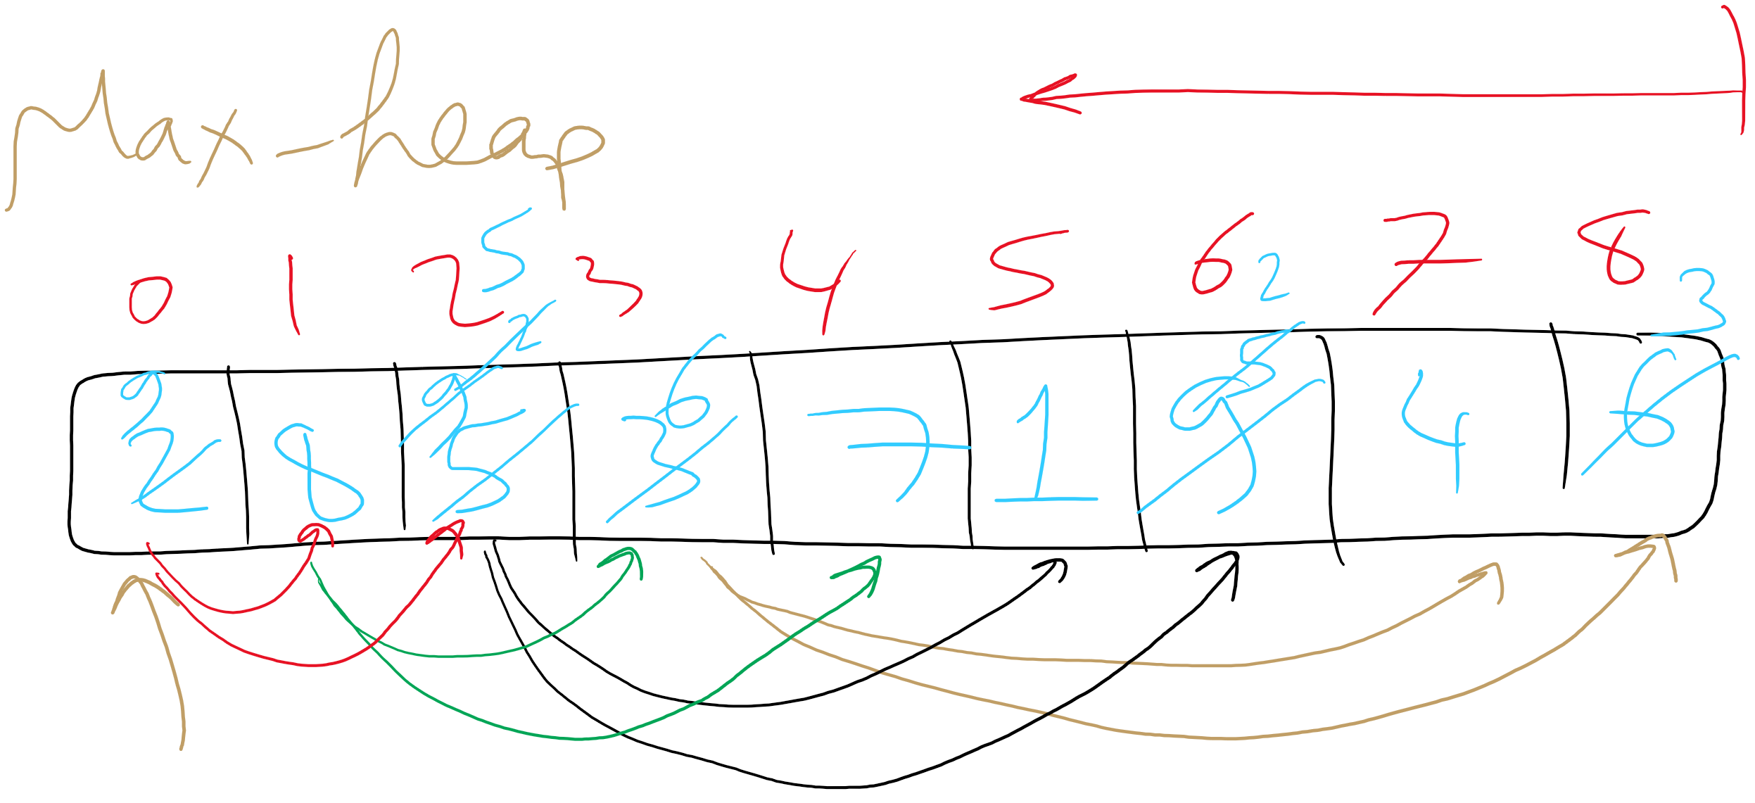
Heapify Example

Slide 33
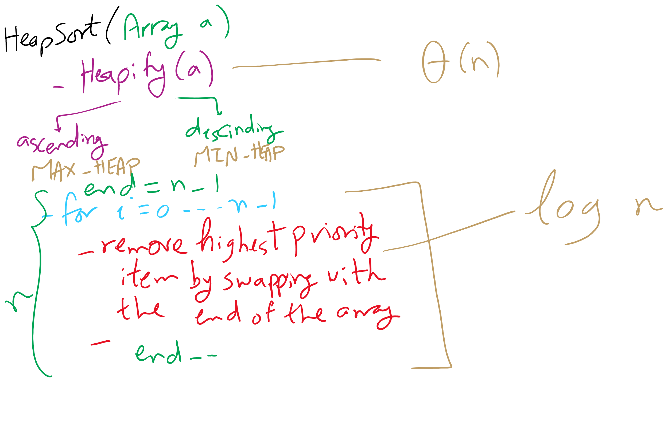
HeapSort Pseudo-code

Slide 34
Heap Sort
Heapify the numbers
MAX heap to sort ascending
MIN heap to sort descending
"Remove" the root
Don’t actually delete the leaf node
Consider the heap to be from 0 .. length - 1
Repeat
37
12
42
3
5
42
7
15
8
9
42
15
37
42
9
37
5
9
7
42
8
15
9
37
15
37
42
37
42
15
12
7
9
15
37
12
42
8
9
8
37
7
15
42
5
9
3

Slide 35
Heap sort analysis
Runtime:
Worst case:
n log n
In-place?
Yes
Stable?
No

Slide 36
Storing Objects in PQ
What if we want to update an Object?
What is the runtime to find an arbitrary item in a heap?
Θ(n)
Hence, updating an item in the heap is Θ(n)
Can we improve of this?
Back the PQ with something other than a heap?
Develop a clever workaround?

Slide 37
Indirection
Maintain a second data structure that maps item IDs to each item’s current position in the heap
This creates an indexable PQ

Slide 38
Indirection example setup
Let's say I'm shopping for a new video card and want to build a heap to help me keep track of the lowest price available from different stores.
Keep objects of the following type in the heap:
class CardPrice implements Comparable<CardPrice>{
public String store;
public double price;
public CardPrice(String s, double p) { … }
public int compareTo(CardPrice o) {
if (price < o.price) { return -1; }
else if (price > o.price) { return 1; }
else { return 0; }
}
}

Slide 39
Indirection example
n = new CardPrice("NE", 333.98);
a = new CardPrice("AMZN", 339.99);
x = new CardPrice("NCIX", 338.00);
b = new CardPrice("BB", 349.99);
Indirection
"NE":0
"NE":2
"AMZN":1
"AMZN":0
"AMZN":1
Update price for NE: 340.00
"NCIX":0
"NCIX":2
"NCIX":3
"NCIX":1
"BB":0
"BB":3
"BB":1
Update price for NCIX: 345.00
Update price for BB: 200.00
a
b
b
x
n
a
x
x
a
x
n
b
Notes:
How are our runtimes affected?
space utilization?
how should we implement the indirection?
what are the tradeoffs?

Slide 40
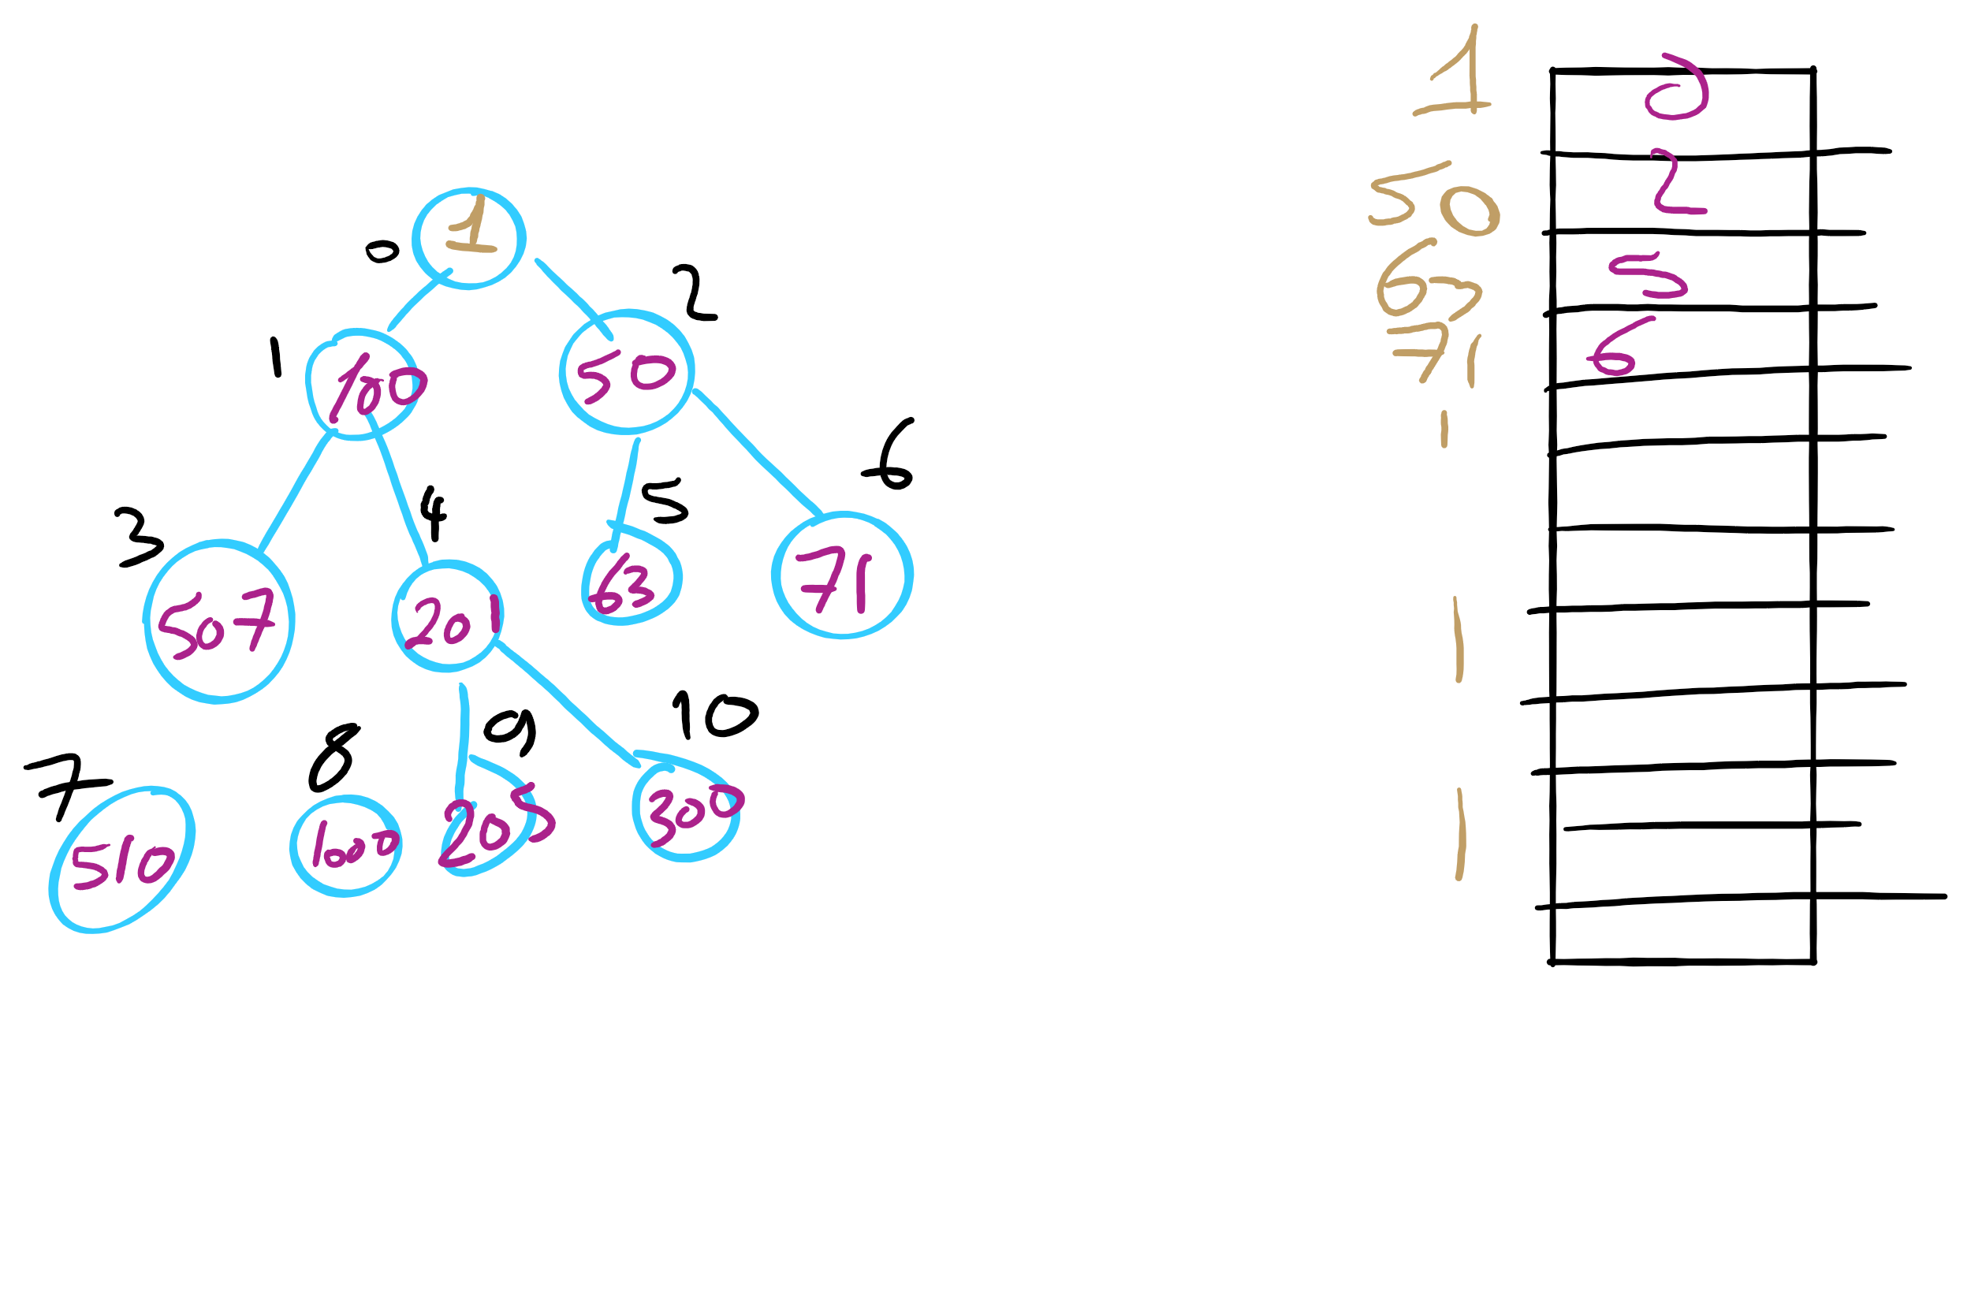
Indexable PQ Example

Slide 41
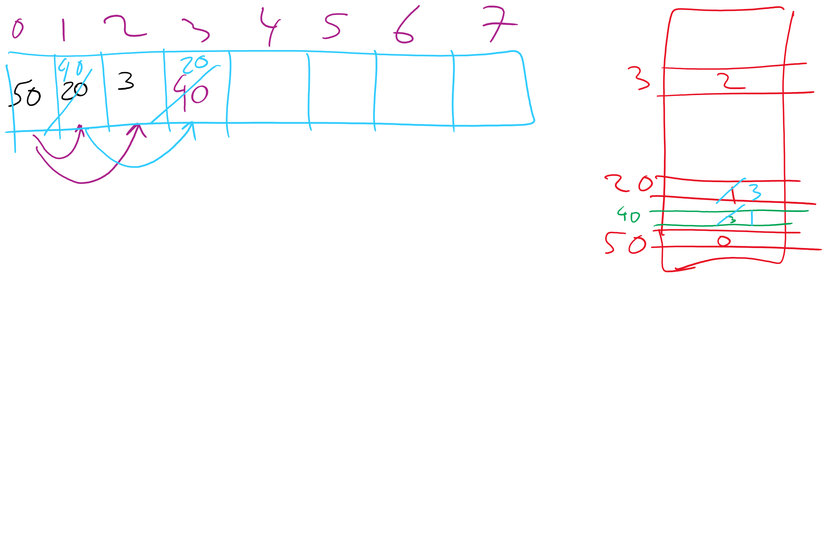
Indexable PQ Example

Slide 42
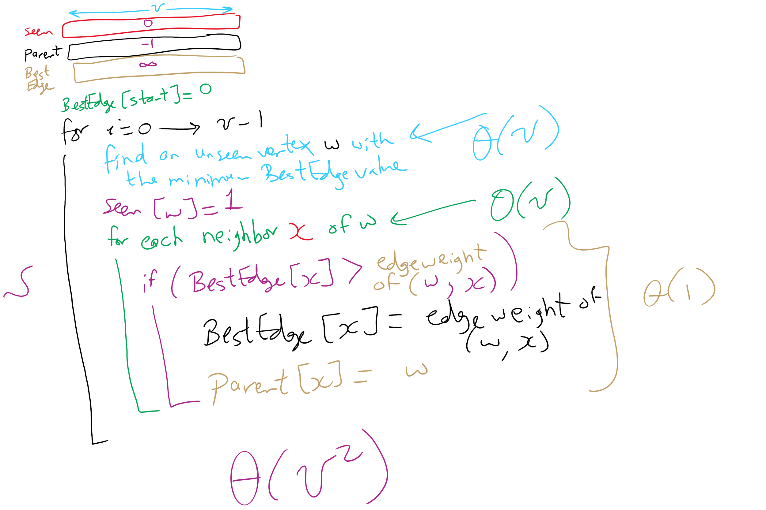
Prim’s MST Algorithm

Slide 43
OK, so what's our runtime?
For every vertex we add to T, we’ll need to check all of its neighbors to check for edges to add to T next
Let's assume we use an adjacency matrix:
Takes Θ(v) to check the neighbors of a given vertex
Time to update parent/best edge arrays?
Time to pick next vertex?
What about with an adjacency list?
Notes:
v vertices will be added to T, so we do the following v times:
Search through the neighbors of the next vertex to adjust the parent and best edge arrays as needed
Constant time to update parent/best edge arrays
Neighbor enumeration:
Matrix:
Θ(v)
List:
Θ(degree)
Search through the best_edge array to find the next addition to T
Θ(v)
So, matrix:
We do v * 2 * Θ(v) work
Θ(v²)
List:
We do v * (Θ(v) + degree) work
Θ(v²)

Slide 44
Prim’s MST: What about a faster way to pick the best edge?
Sounds like a job for a priority queue!
Priority queues can remove the min value stored in them in Θ(lg n)
Also Θ(lg n) to add to the priority queue
What does our algorithm look like now?
Visit a vertex
Add edges coming out of it to a PQ
While there are unvisited vertices, pop from the PQ for the next vertex to visit and repeat
Notes:
Change in runtime?
θ(d) work to list neighbors,
in the worst case, v == d, so no asymptotic improvement, but a practical one.
Less memory required to store the graph
but doesn't affect memory required to run the algorithm, still need 2 * θ (v) to store parent and best edge arrays
this version of Prim's just adds all edges to a PQ
before we constrained ourselves to only maintain v best edges to look at
how do we get the best of both?
indexable pq

Slide 45
Prim's with a priority queue
0
0
PQ:
6
5
1
1
3
1: (0, 2)
1
3
2: (5, 3)
5
5
3: (1, 4)
2
2
3
2
4: (2, 5)
6
4
5: (2, 3)
5: (0, 3)
4
5
4
5
6
5: (2, 1)
6: (0, 1)
6: (2, 4)
6: (5, 4)

Slide 46
Runtime using a priority queue
Have to insert all e edges into the priority queue
In the worst case, we’ll also have to remove all e edges
So we have:
e * Θ(lg e) + e * Θ(lg e)
= Θ(2 * e lg e)
= Θ(e lg e)
This algorithm is known as lazy Prim’s
Notes:
discuss why this isn't lg v for PQ operations, lead to how we constrained number of best edges before to be v, lead to indexable PQ discussion

Slide 47
Do we really need to maintain e items in the PQ?
I suppose we could not be so lazy
Just like with the adjacency matrix implementation, we only need the best edge for each vertex
PQ will need to be indexable
This is the idea of eager Prim’s
Runtime is Θ(e lg v)

Slide 48
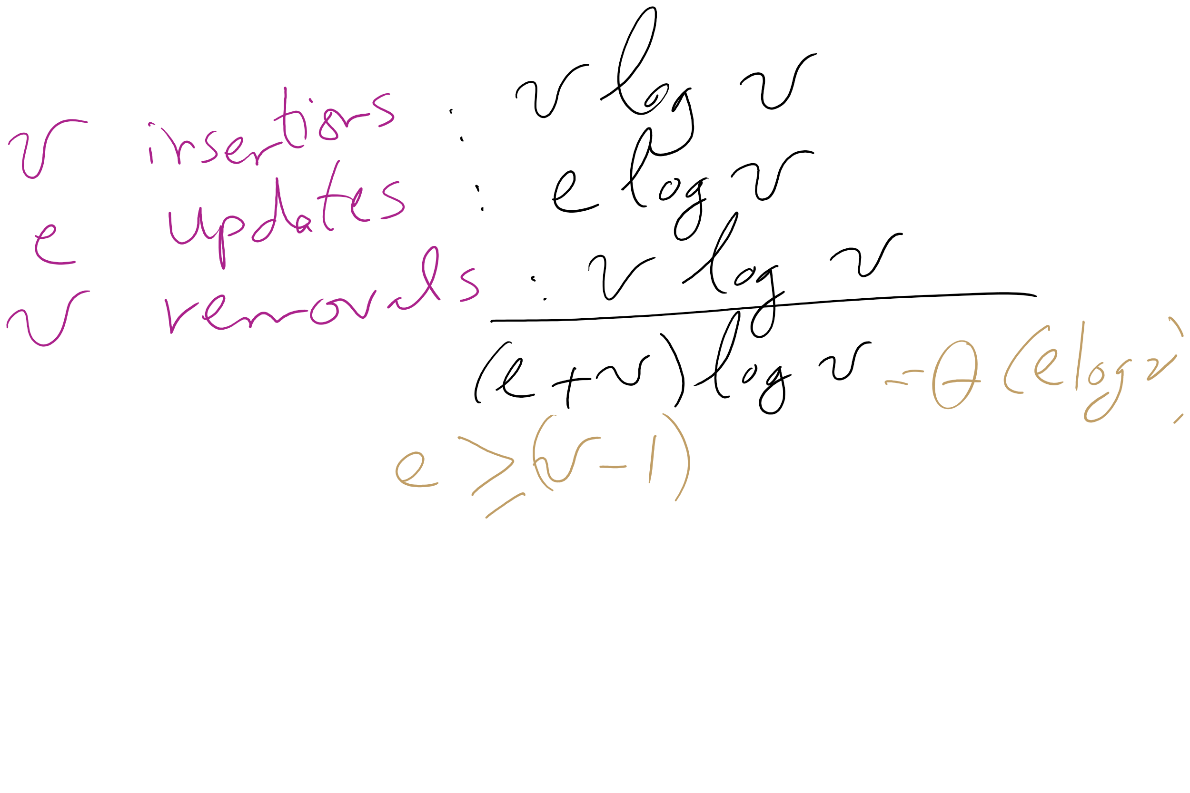
Eager Prim’s Runtime

Slide 49
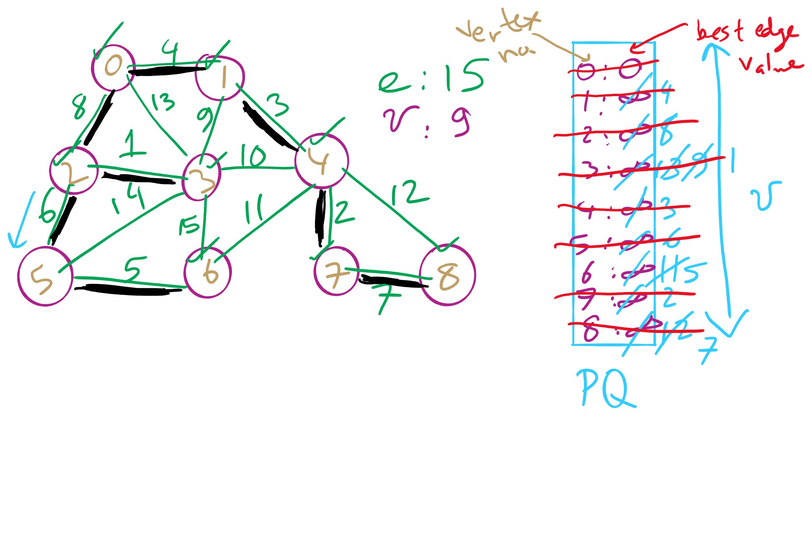
Eager Prim’s Example 1

Slide 50
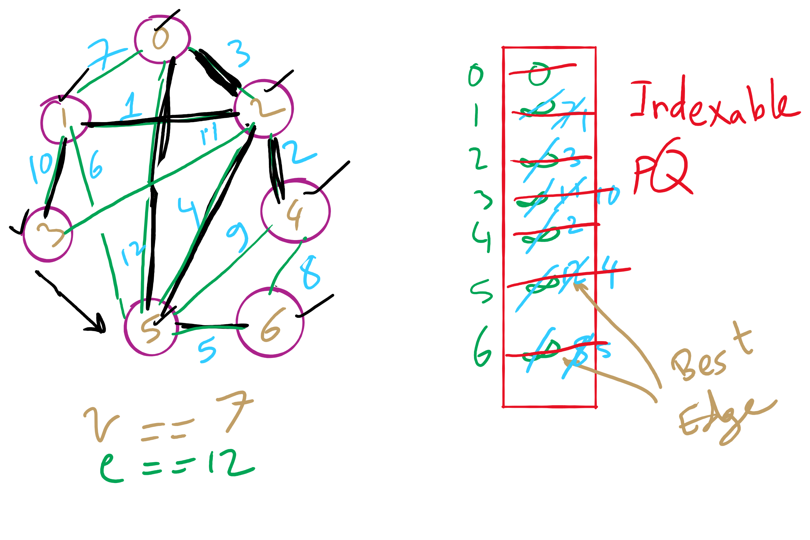
Eager Prim’s Example 2

Slide 51
Please submit your reflections by using the CourseMIRROR App
If you are having a problem with CourseMIRROR, please send an email to coursemirror.development@gmail.com
Notes:
All right!
Upcoming Due Dates at A Glance

